Slide 1

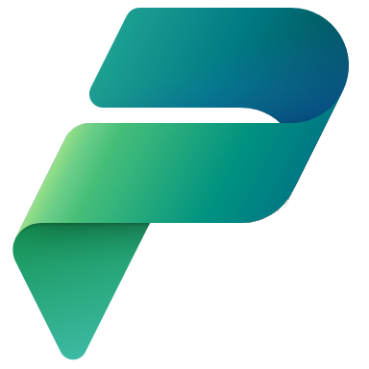
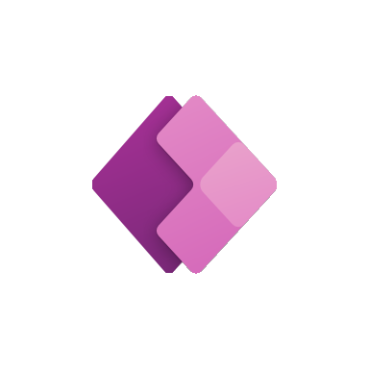



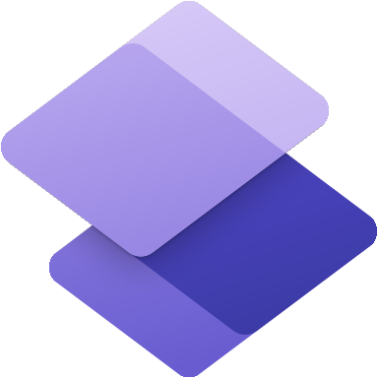

Microsoft Power Platform
Community Call
Welcome to the July 2022
Power Platform Community Call!
July 20th, 2022

Slide 2





Agenda
Latest updates and news on Power Platform
Monthly Community Tip
Group picture time with Together Mode!
Demos
Lindsay Shelton - Building a SharePoint Document Library Approvals System
Dian Taylor - Microsoft Teams Approvals in Dynamics 365 using Power Automate
Norm Young - How to connect Dataverse to Microsoft Teams

Slide 3
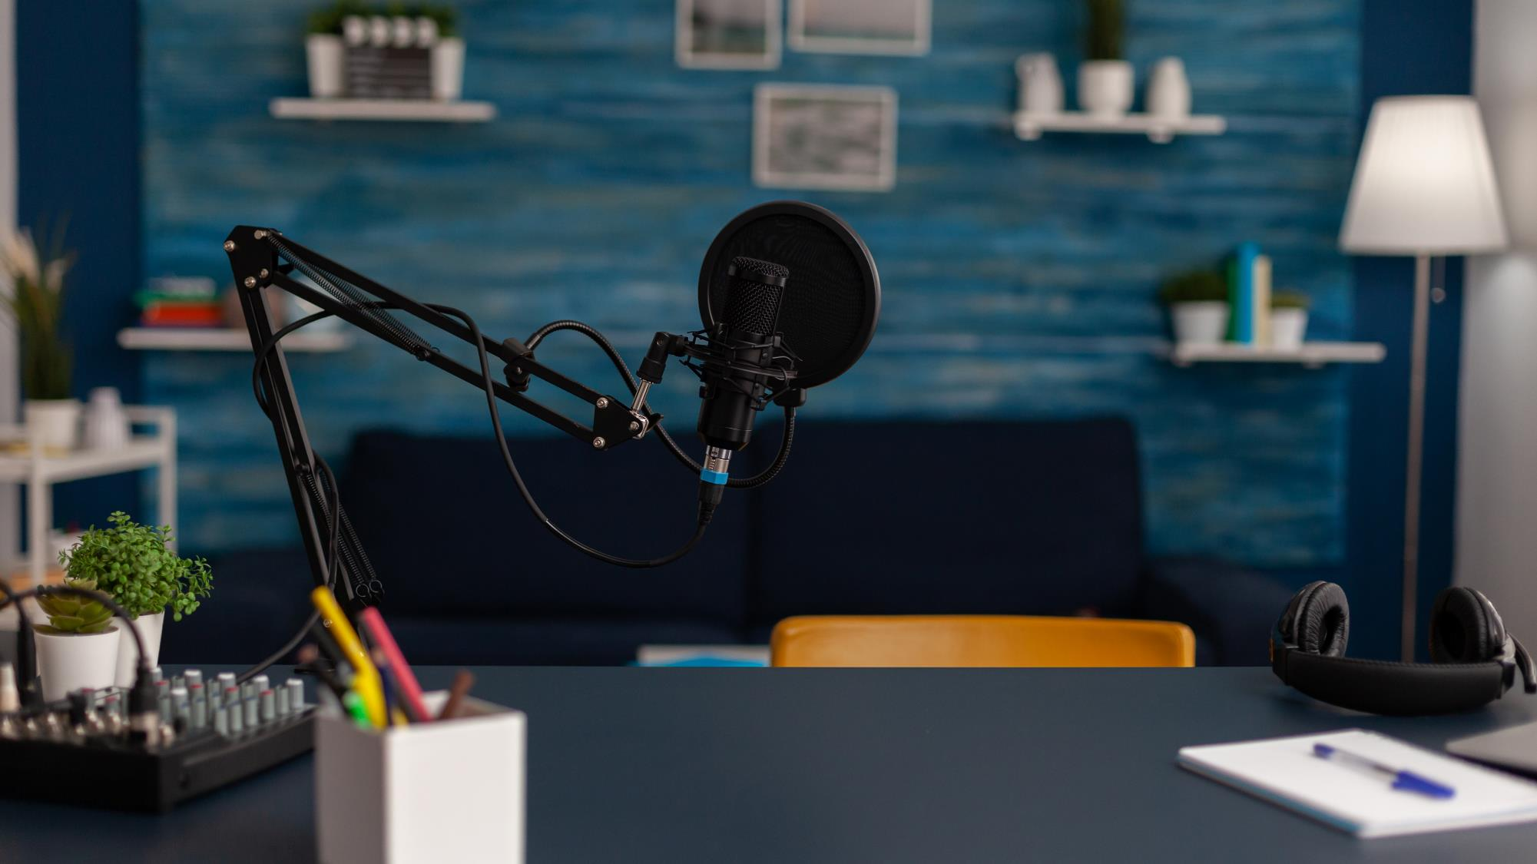

Request to Present We welcome everyone to present a demo on the Power Platform Community Call. Everyone is welcome!!!
https://aka.ms/PPCCDemoRequest

Slide 4
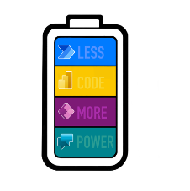
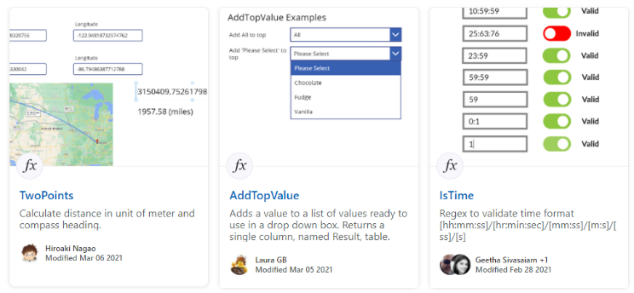
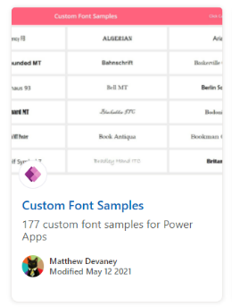
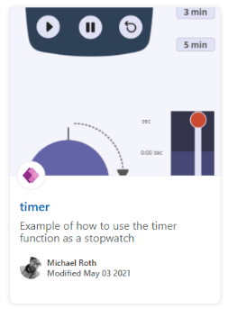
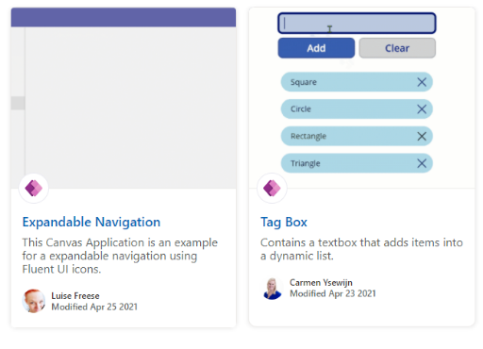
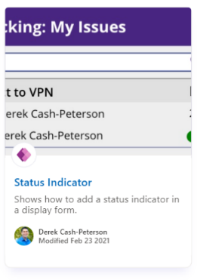
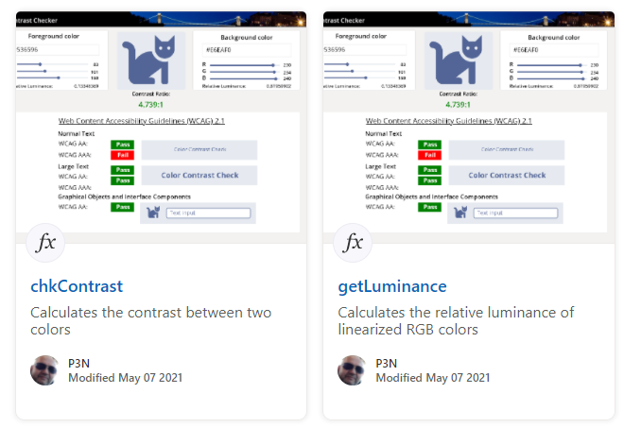
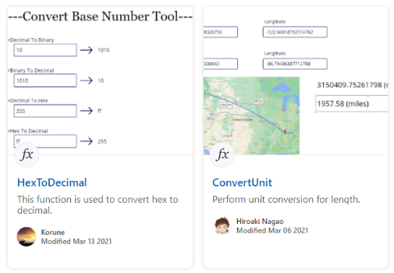
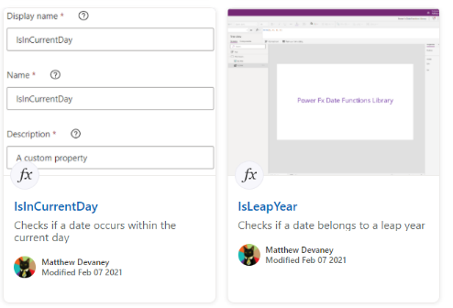
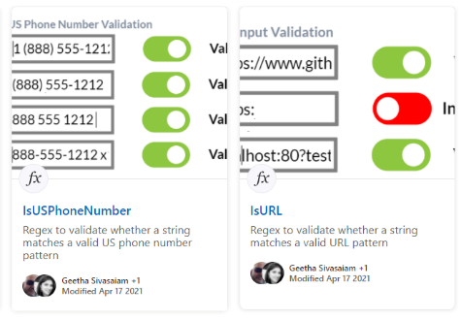
Power Platform Samples
https://aka.ms/powerplatform-samples ​
https://adoption.microsoft.com
Power Apps templates​
Power Apps components​
Power Apps connectors​
Power Fx Custom Functions
Power Automate flow templates​​
PowerBI​​
Power Virtual Agents​​

Slide 5
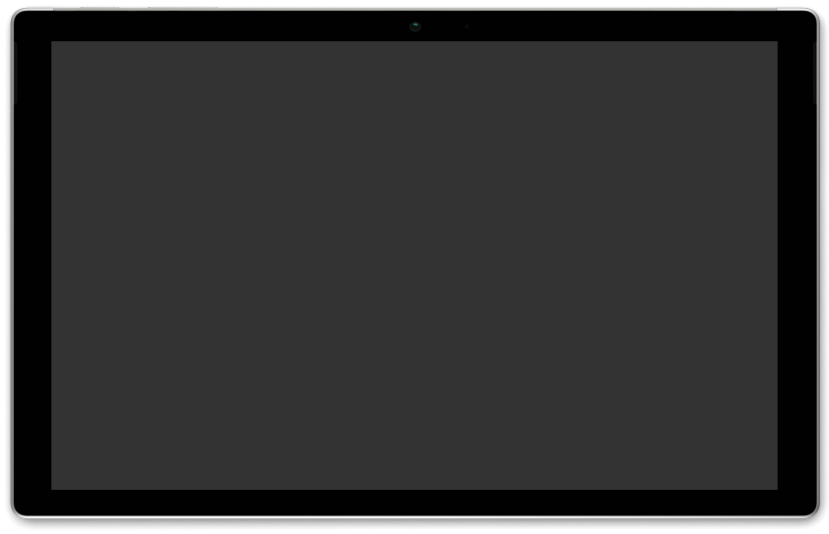
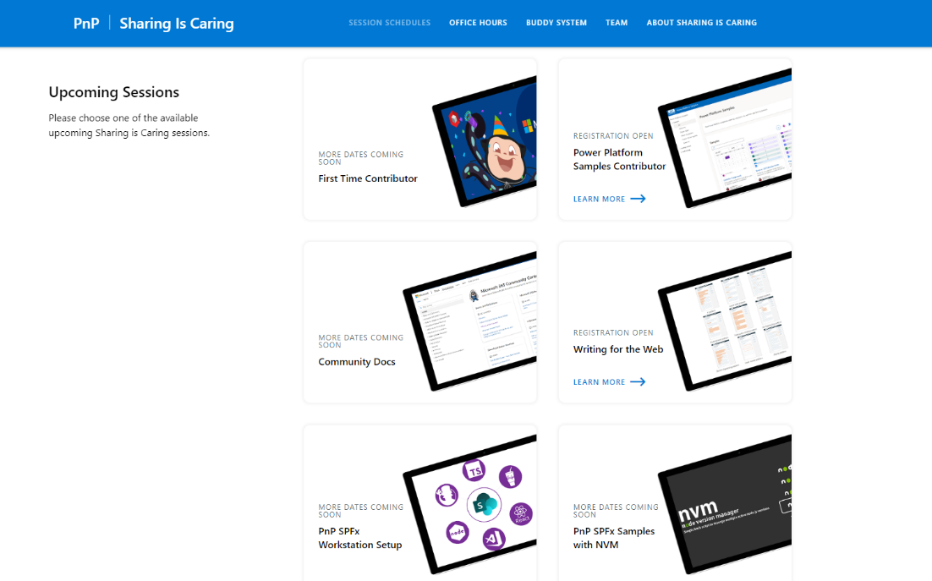
GUIDANCE
Learn how to get started in the open-source community!
Upcoming Sessions:
First-time contributor
Power Platform Samples Contributor
Writing for the Web
Community Content Docs
SPFx Developer Workstation Setup
Using PnP SPFx samples w/ NVM
More than code with VS Code
Coming Soon: Power Pages -- 2 Part Session
Join the Power Platform Contributors
Sharing is Caring Session – TODAY
https://aka.ms/sharing-is-caring
Notes:
25 Total attendees, 16 attendees who attended both First-Time Contributors and Community Docs sessions.

Slide 6

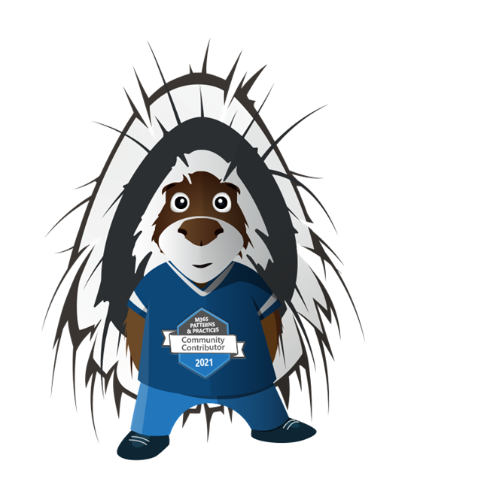





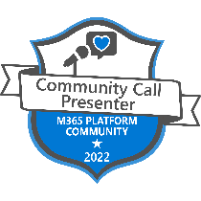
COMMUNITY
Community Recognition Program
Showcasing your contributions
Powered by Credly
More achievement levels coming soon
https://aka.ms/m365pnp-recognition
Notes:
25 Total attendees, 16 attendees who attended both First-Time Contributors and Community Docs sessions.

Slide 7

Power Platform Community Events

Slide 8
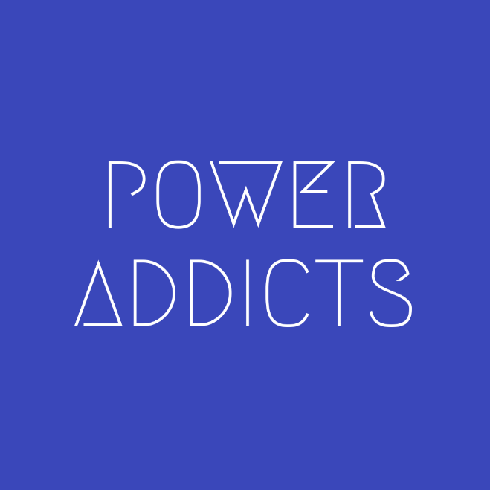
Power Addicts Hangout
#PowerAddict : An individual with an almost obsessive need and desire to bring positive change, solve problems and automate processes with the Microsoft Power Platform.
https://WeArePowerAddicts.com

Slide 9
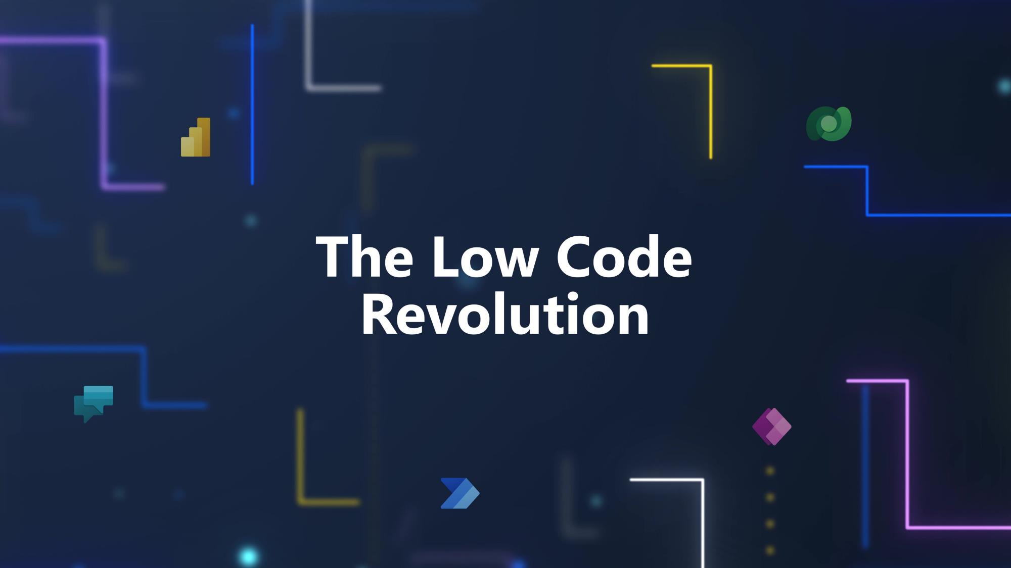

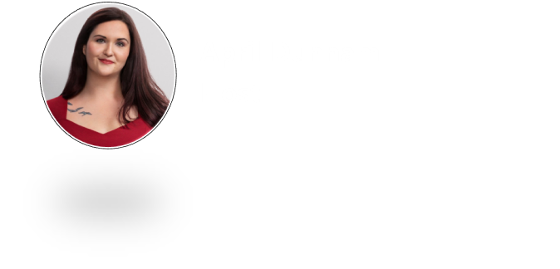

Slide 10
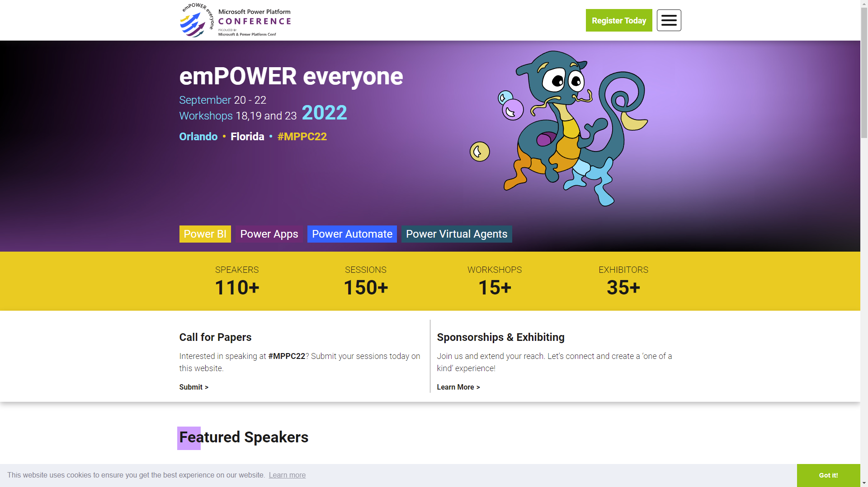
https://powerplatformconf.com/
Notes:
https://powerplatformconf.com/
Early bird ends July 25th

Slide 11

Monthly Community Quick Tip
“You can use the Toggle control to create reusable functions!”
Todd Baginski
Notes:
“This month we are excited to start a new segment in the Community Call - the Monthly Community Quick Tip. In this segment we plan to showcase a Power Platform tip from the community. To get the party started, I’ll present my own Quick Tip this month. Then, in future month’s I’ll present the tips from the community. If you have a Quick Tip, please reach out to us and submit your idea. https://aka.ms/PPCCDemoRequest”
Section where we share a share a super short Power Platform tip from the community in 90-120 seconds.
The tip could point to a blog or video that has a longer in-depth explanation.
Slide 1 – Header – Title
Slide 2 - Tip
Slide 3 – Full screen image (text in notes)
Slide N – Full screen image (text in notes)
Slide 4 – Learn more link

Slide 12
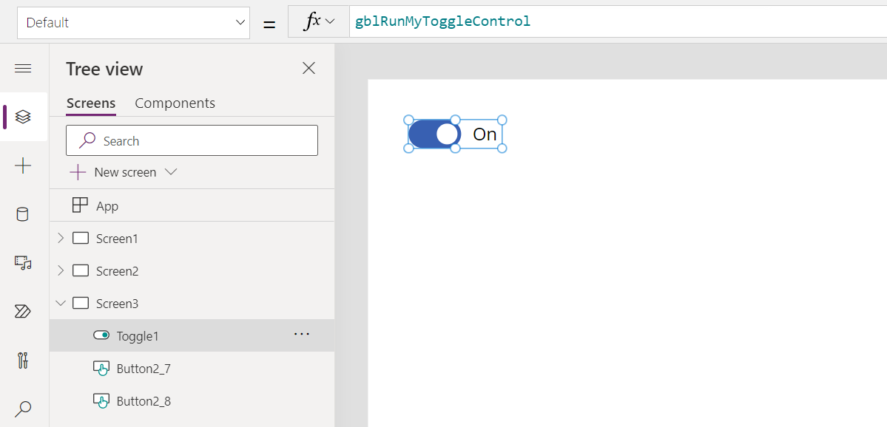
Monthly Community Quick Tip
You can use the Toggle control to create reusable functions!
Notes:
Set the Default property of a Toggle control to a global variable.
gblRunMyToggleControl

Slide 13
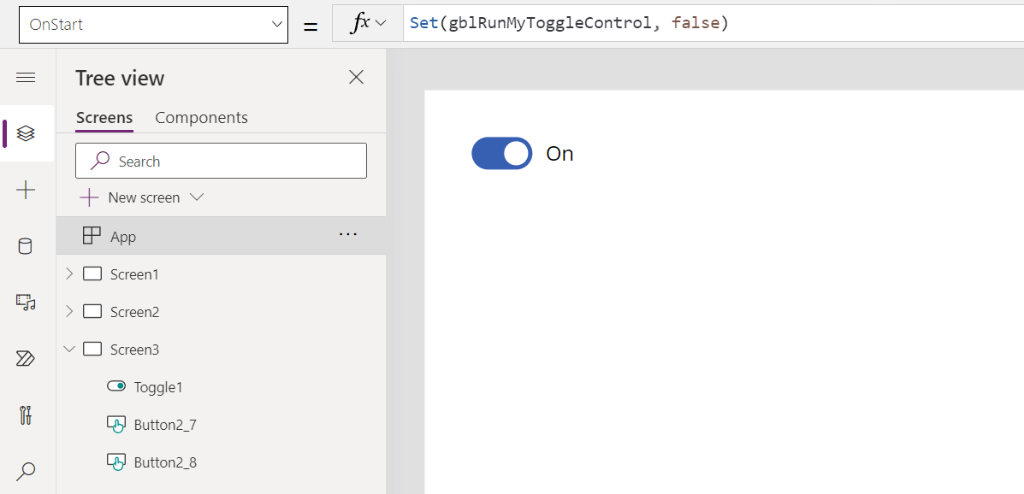
Monthly Community Quick Tip
You can use the Toggle control to create reusable functions!
Notes:
In App OnStart, set the Global variable to false.
Set(gblRunMyToggleControl, false)

Slide 14
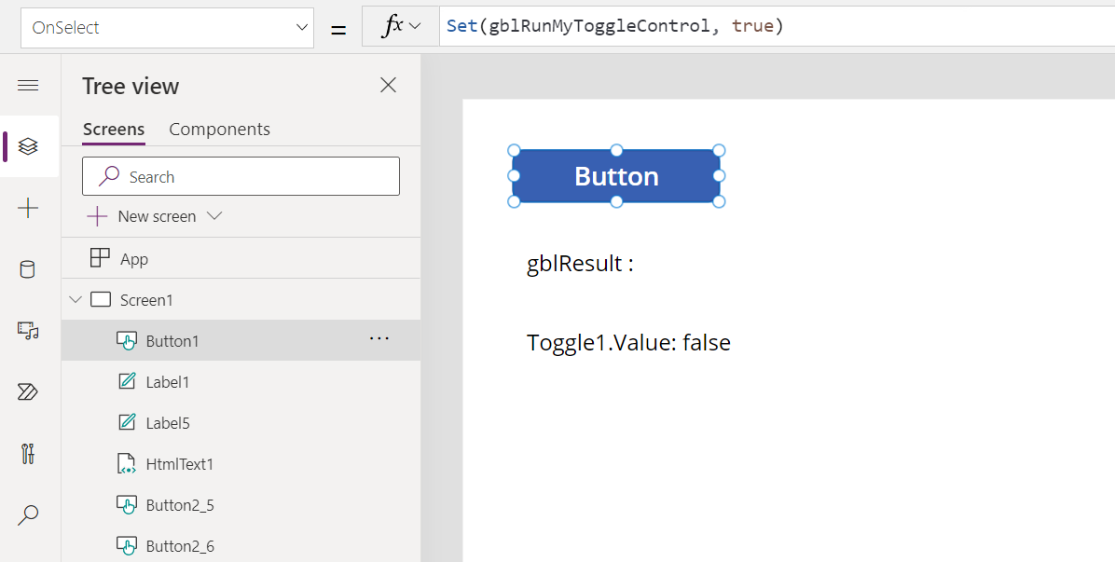
Monthly Community Quick Tip
You can use the Toggle control to create reusable functions!
Notes:
Set the global variable to true to cause the Toggle control to fire. You can do this in a Button’s OnSelect function.
Set(gblRunMyToggleControl, true)

Slide 15
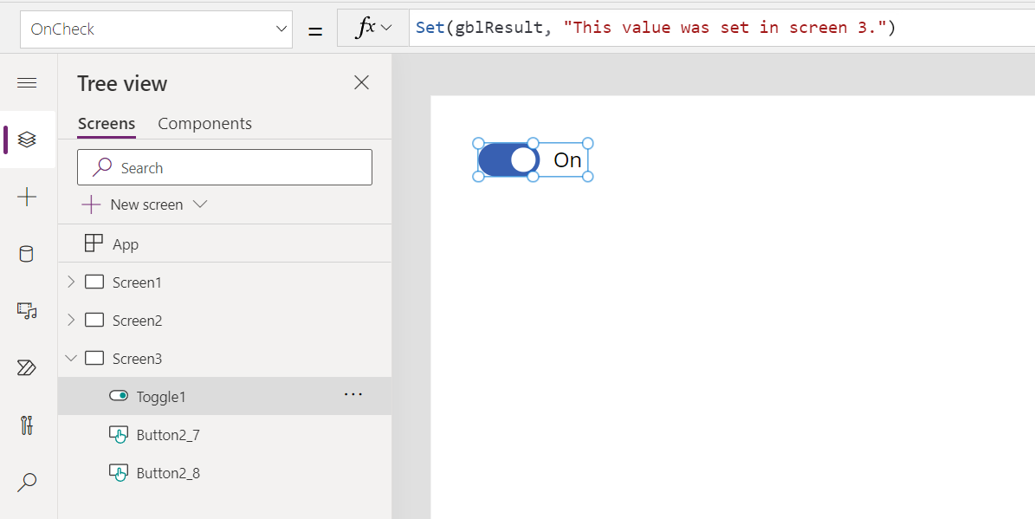
Monthly Community Quick Tip
You can use the Toggle control to create reusable functions!
Notes:
When the gblRunMyToggleControl value changes, the OnCheck method fires in the Toggle control and runs the reusable code to set another global variable.
Set(gblResult, "This value was set in screen 3.")

Slide 16
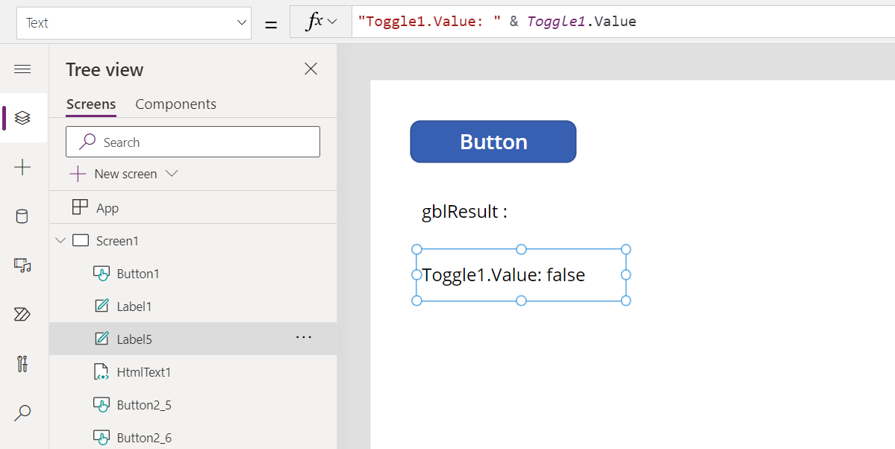
Monthly Community Quick Tip
You can use the Toggle control to create reusable functions!
Notes:
Add a direct data reference to the Toggle control on the screens that call it to ensure it fires without navigating to the page where the toggle control exists. A label is a perfect place to do this. You can easily hide the labels if desired.
"Toggle1.Value: " & Toggle1.Value

Slide 17
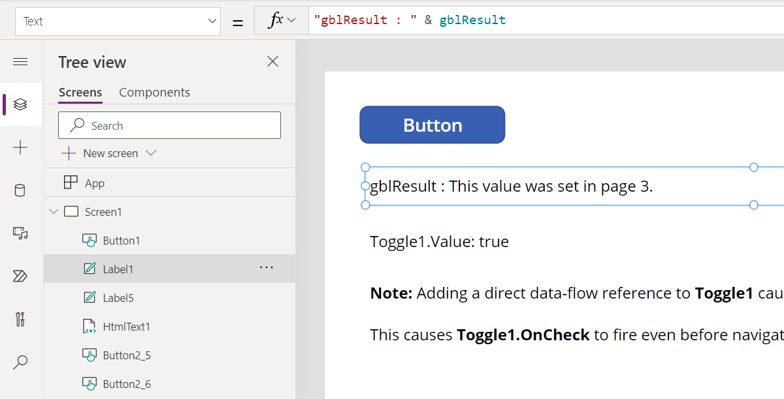
Monthly Community Quick Tip
You can use the Toggle control to create reusable functions!
Notes:
Controls on other pages in the app can access the Global variable set by the Toggle control.
gblResult

Slide 18
Monthly Community Quick Tip
You can use the Toggle control to create reusable functions!
Learn More!
https://youtu.be/8qb1mebJl5Y
Share your Community Quick Tips!
https://aka.ms/PPCCDemoRequest
Notes:
https://youtu.be/8qb1mebJl5Y

Slide 19
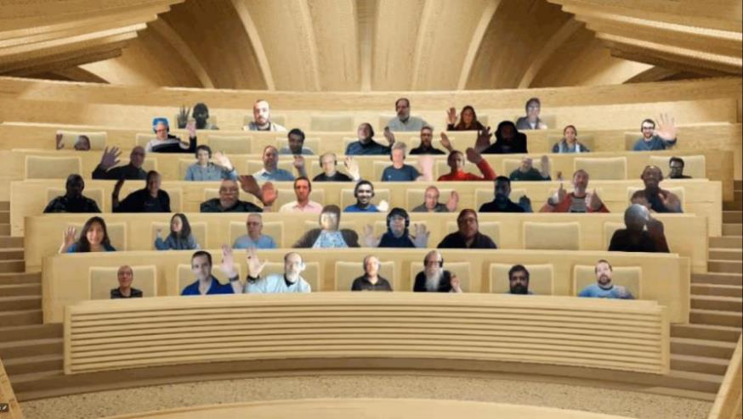

Optional picture time!
Turn your video on and we’ll grab a Together Mode picture with everyone willing to participate.
We are together in this as a community!
By enabling your camera for the picture, you’ll give us the permission to share your picture in social media.

Slide 20




DEMO
Building a SharePoint Document Library Approvals System – Lindsay Shelton
Microsoft Teams Approvals in Dynamics 365 using Power Automate – Dian Taylor
How to connect Dataverse to Microsoft Teams – Norm Young
Notes:
Notes about each demo go here.

Slide 21
Resources

Slide 22
Learn more with these helpful resources!
Power Apps Training Resources
https://aka.ms/PowerAppsTraining
Power Apps Community
https://Community.PowerApps.com
Power Apps Community Samples
https://aka.ms/PowerAppsCommunitySamples
Power Apps Community Videos
https://aka.ms/PowerAppsCommunityVideos
PowerPlatformLearn Resources
https://www.powerplatformlearn.academy
PnP Power Platform Samples
https://www.aka.ms/powerplatform-samples

Slide 23
Microsoft 365 developer community calls
Microsoft 365 platform (weekly) https://aka.ms/m365-dev-call
(Notice. This call is on a summer break between July 1st and 31st of August 2022)
Adaptive Cards https://aka.ms/adaptivecardscommunitycall
Microsoft identity platform https://aka.ms/IDDevCommunityCalendar
Office Add-ins https://aka.ms/officeaddinscommunitycall
Power Platform https://aka.ms/PowerPlatformCommunityCall
Microsoft 365 & Power Platform Development (bi-weekly) https://aka.ms/m365-dev-sig
Viva Connections & SharePoint Framework (bi-weekly) https://aka.ms/spdev-spfx-call
Download recurrent invites from
https://aka.ms/m365/calls
Notes:
m365-dev-sig

Slide 24
Thank you
Recording will be available soon on the
Microsoft 365 Community (PnP) YouTube channel
https://aka.ms/M365PnP/videos
(subscribe today)
Follow us on Twitter
@Microsoft365Dev | @M365PnP
Next call: August 17, 2022 at 08:00am PST
https://aka.ms/powerplatformcommunitycall
See all other community calls at http://aka.ms/m365pnp
Notes:
https://aka.ms/M365PnP/videos
https://aka.ms/powerplatformcommunitycall
http://aka.ms/m365pnp

